Slide 1

T.S.I.
TEACHER STUDENT INTERFACE
By
TEJAS D. PANDIT
AJAY A. POWAR
JAY A. POWAR
Under the guidance of
PROF. A.S. YADAV

Slide 2
INTRODUCTION
This software project involves simple Interface between students and teacher.
while programming practical , problem solving sessions (computer related), we can see lack of communication between students and faculty.
This project will play role of Interface .
Socket programming being implemented in project.

Slide 3



COMMUNICATION MEDIA
According to survey, nowadays people are more comfortable in communication media.
Most of them are teenagers (students).
Teachers are also using applications to establish connection with students (GEMS).

Slide 4
NEED OF WORK
Wastage of Time can be solved.
Better Understanding .
Increase Interest among the students to attend the sessions.
Faculty can’t reach each student due to time restriction.
Silence can be maintained.

Slide 5
Problem statement
Implementing the socket programing (TCP) techniques to reduce the difficulties generating while practical sessions (related to computer practicals only).

Slide 6

Objectives
INTERFACE
DISCUSSION
QUERIES
SHARE

Slide 7
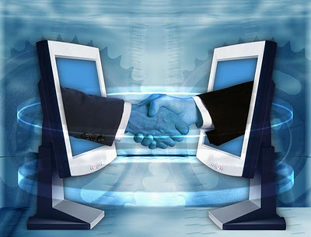
INTERFACE

Slide 8

DISCUSSION

Slide 9

QUERIES
Faculty can solve queries of each student through TSI.
Maximum queries can be solved.

Slide 10
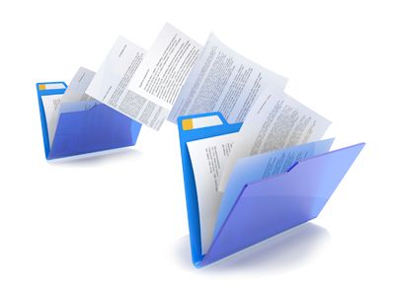
SHARE
File(Program File) Transfer

Slide 11
PROPOSED SOLUTION
In TSI , Socket programming using client , server concept teacher does not need to go to particular student but by using server it can easily interact (chat/communicate) with each and every student. It will not only save Time but also make interaction more practical friendly.

Slide 12
ARCHITECTURAL MODEL

Slide 13
Student 4
Student 3
Student N
Student 2
DB
Teacher
(Server)
Student 1

Slide 14
PROGRAM FLOWCHART AND EXPLAINATION

Slide 15
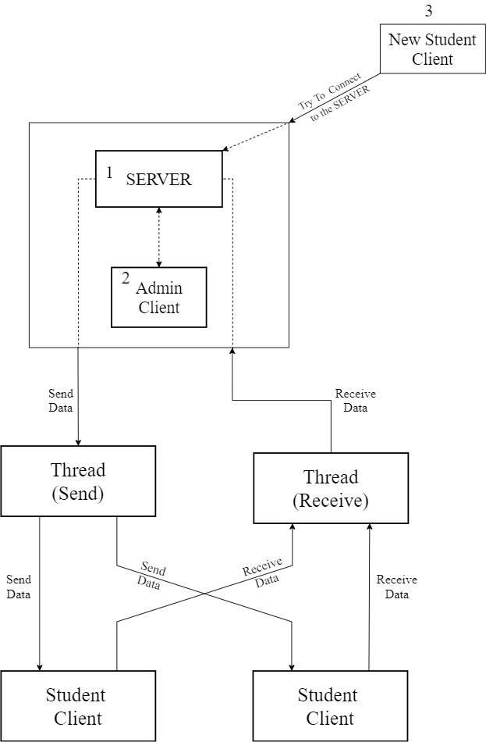

Slide 16
Implementation Details
A) Technology used
SOCKET PROGRAMMING (TCP).
POSIX Threads.

Slide 17
Implementation Details
B) Software and Hardware requirements.
Software :
Any Version of Ubuntu (LINUX) with C / C++ compiler.
Hardware :
Desktop machines/laptop , LAN connection.

Slide 18
CONCLUSION
By using TSI , interaction will become very smooth and fast , and Teacher can easily communicate and get access to each and every student easily.

Slide 19

REFERENCE :
1. SOCKETS IN C - https://www.geeksforgeeks.org/socket-programming-cc/
2. Multithreading Concept - https://www.geeksforgeeks.org/multithreading-c-2/
3. Signals in C - https://www.tutorialspoint.com/c_standard_library/c_function_signal.htm
4. Commandline Concept - https://www.javatpoint.com/command-line-arguments- in-c

Slide 20
Program Execution and Output

Slide 21
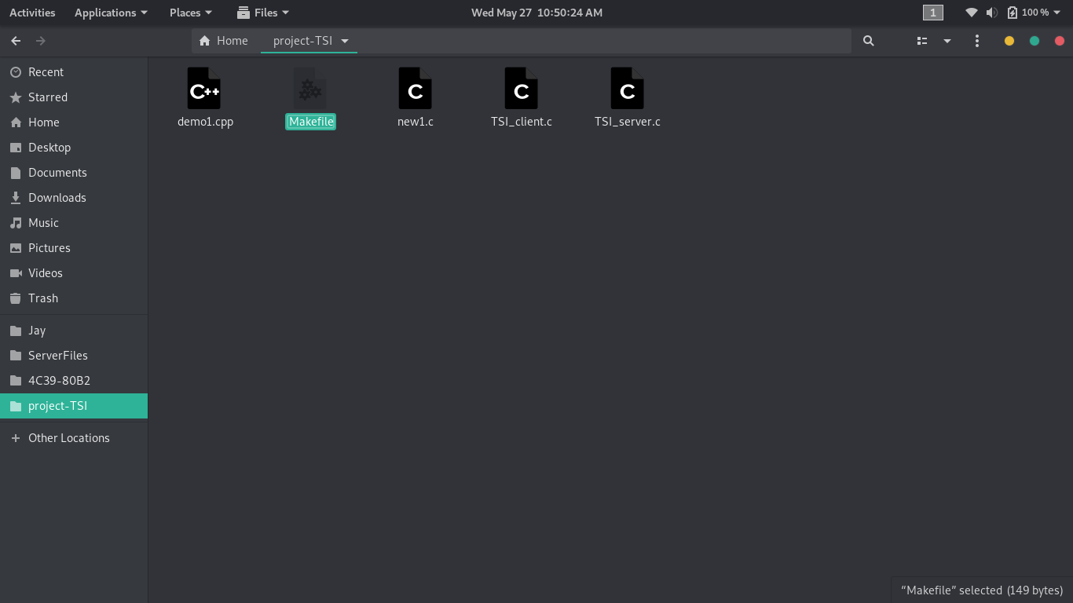
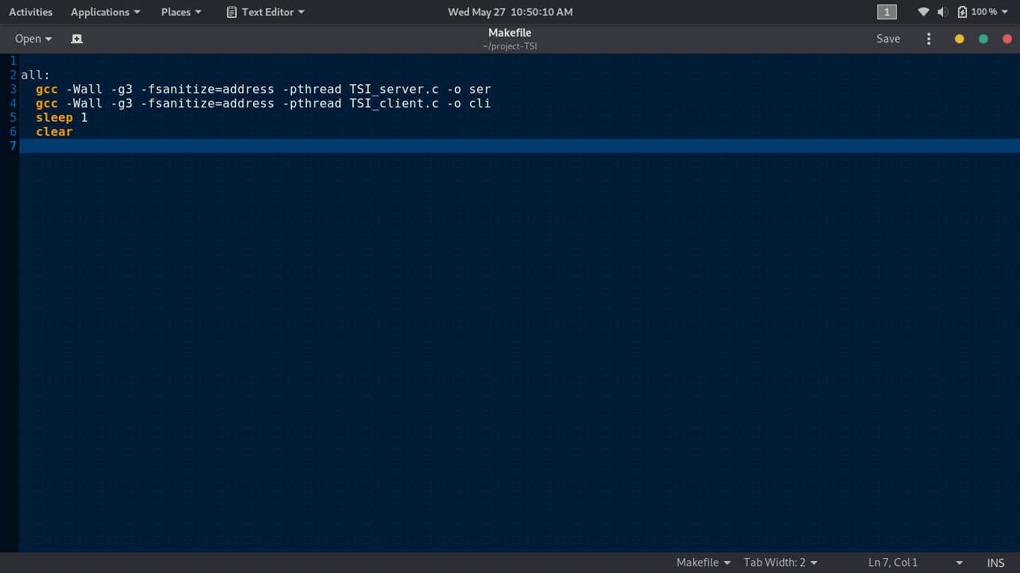
Compilation using Makefile concept

Slide 22
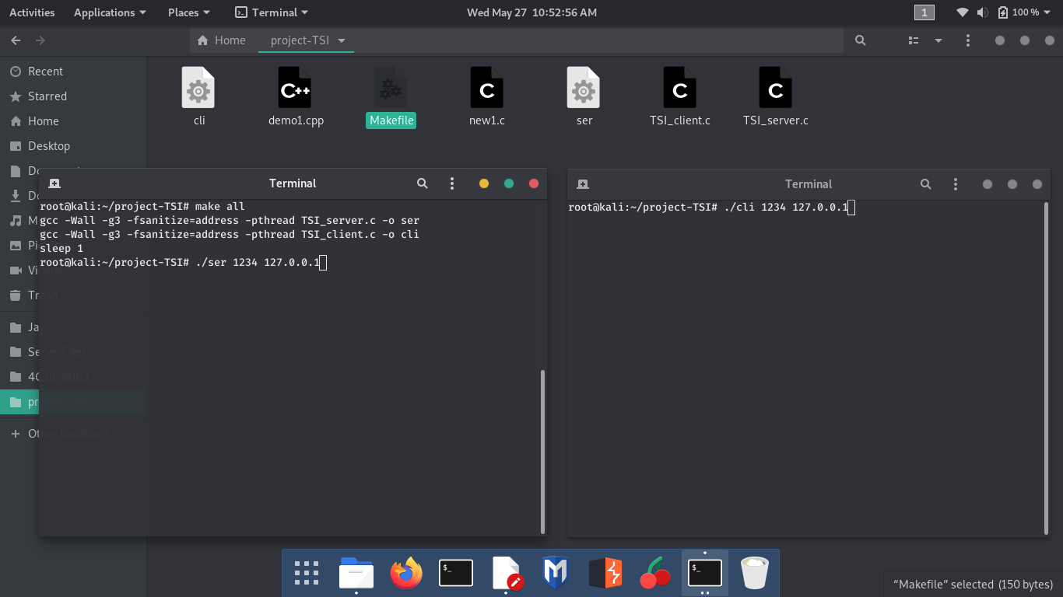
Execution of TSI

Slide 23
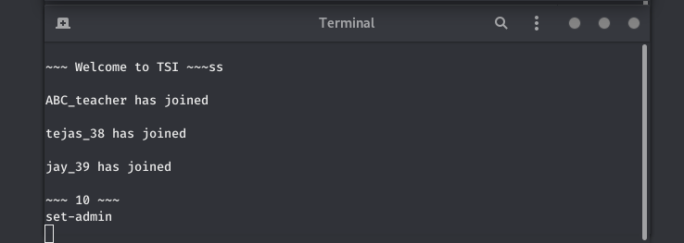
ADD/REMOVE CLIENTS

Slide 24
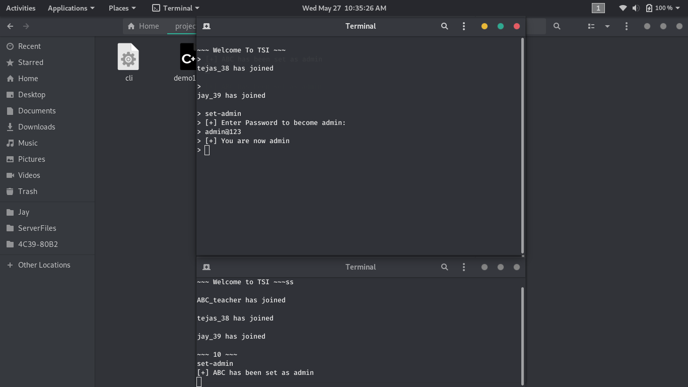
ADMIN LOGIN

Slide 25
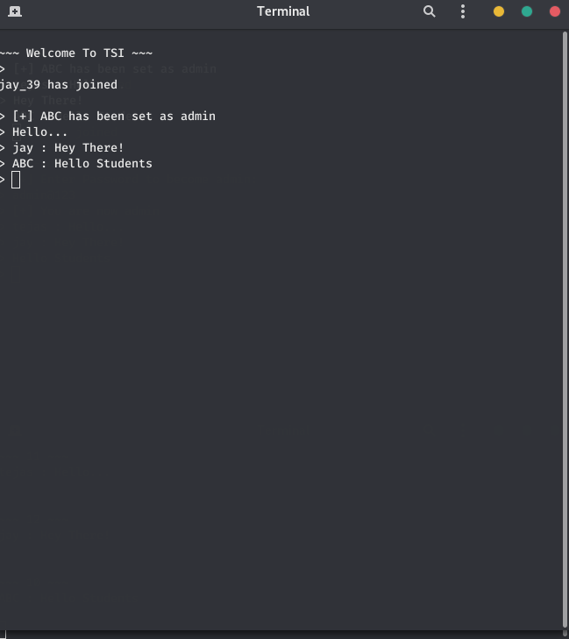
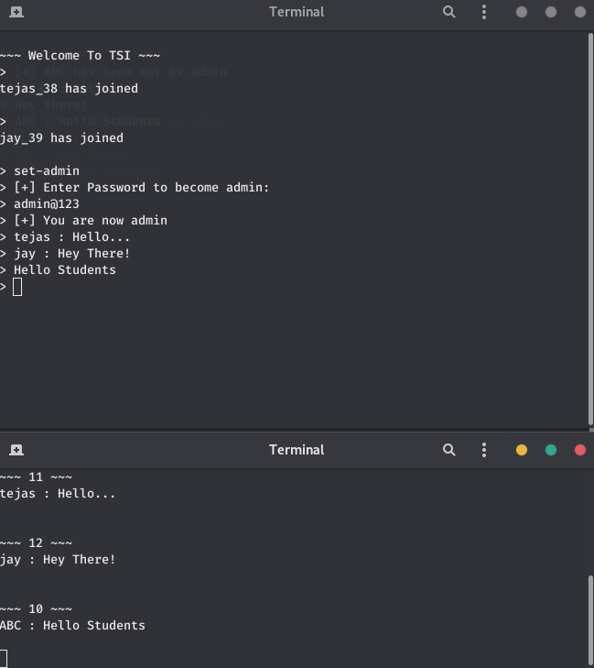
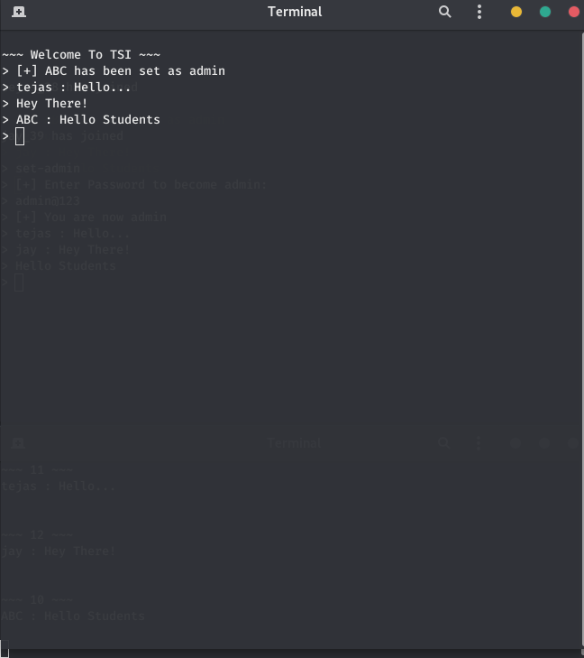
Interaction

Slide 26
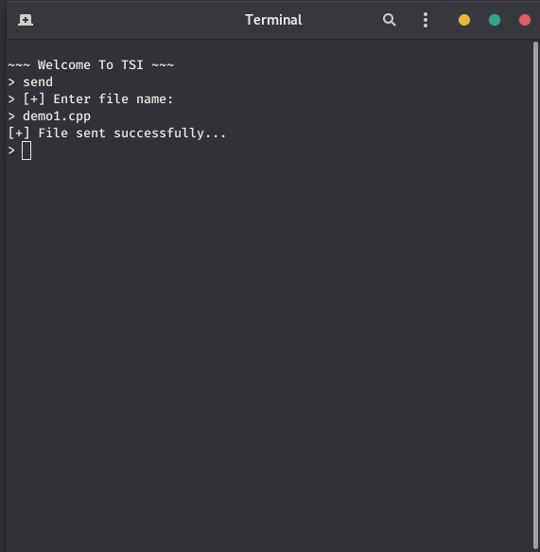
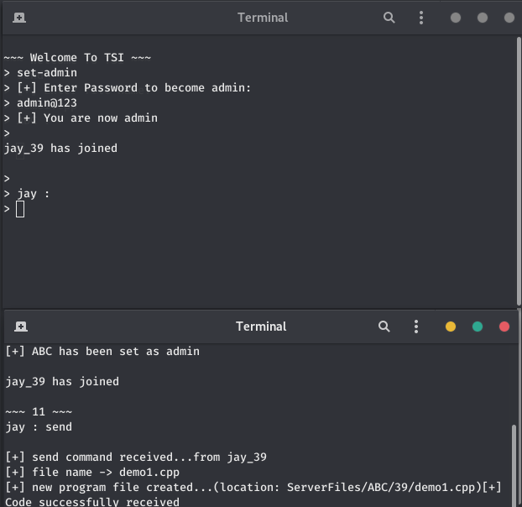
Sending File From Student(Client) To Teacher(Admin-Client)

Slide 27
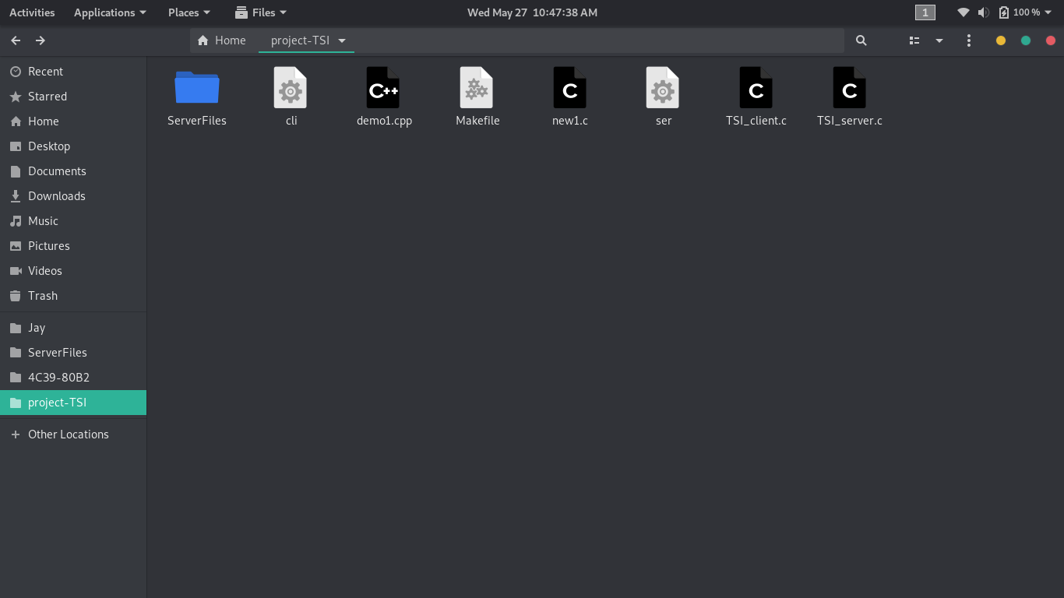
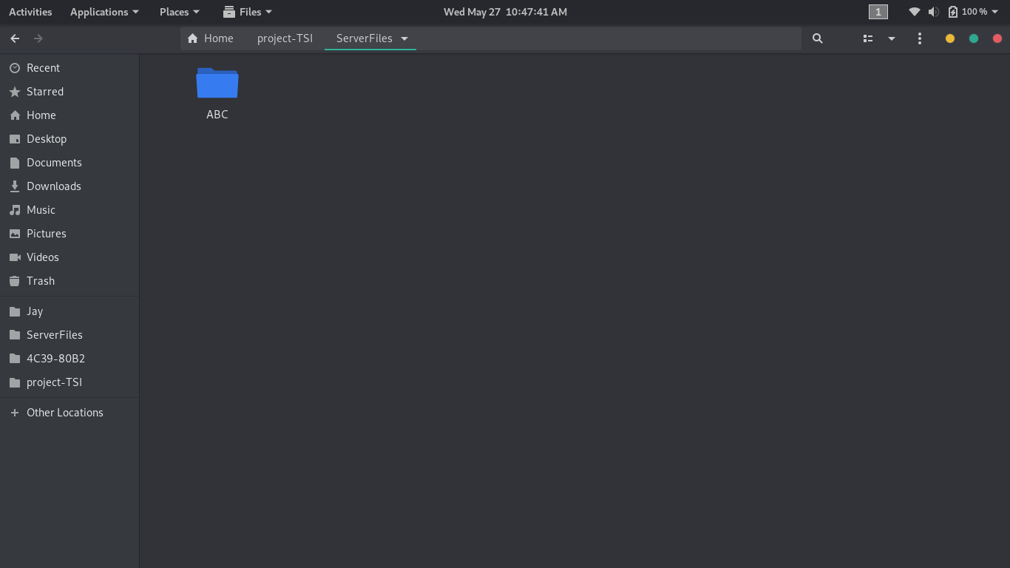
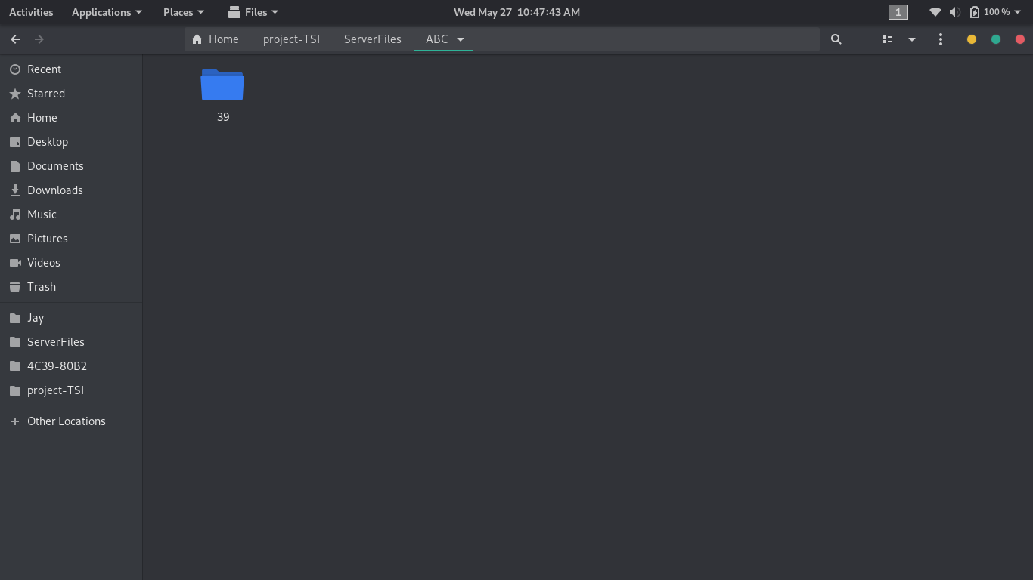
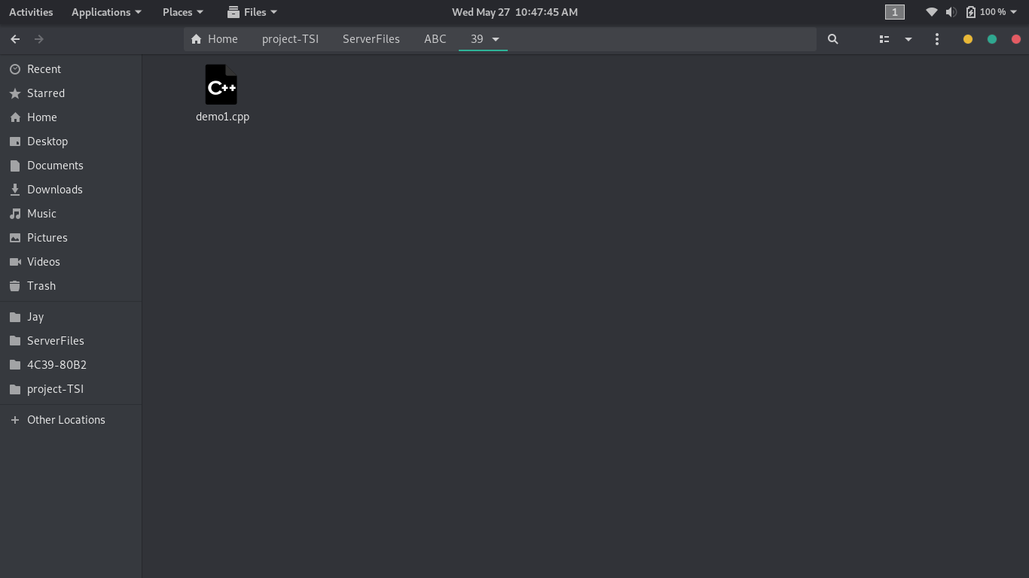

Slide 28
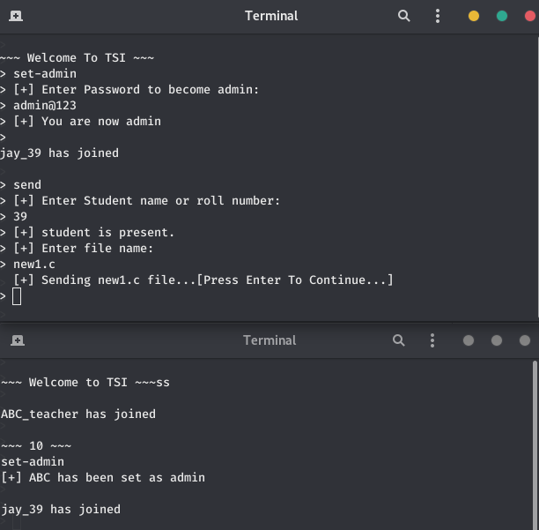
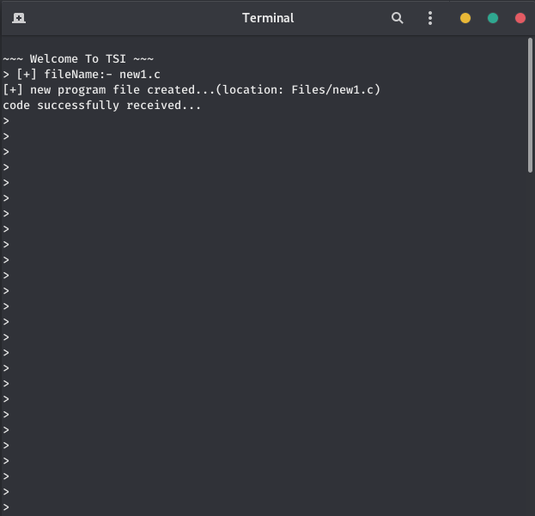
Sending File From Teacher(Admin-Client) To Student(Client)

Slide 29



